Slide 1
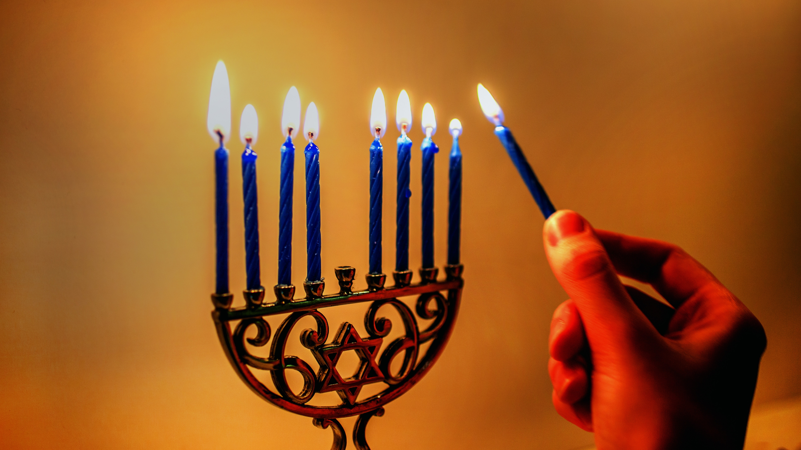

Slide 2

Candle 1 - Peace

Slide 3
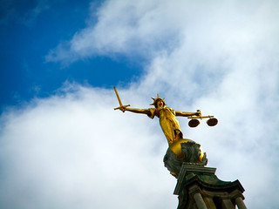
Candle 2 - Justice
This Photo by Unknown Author is licensed under CC BY

Slide 4

Candle 3 - Compassion

Slide 5
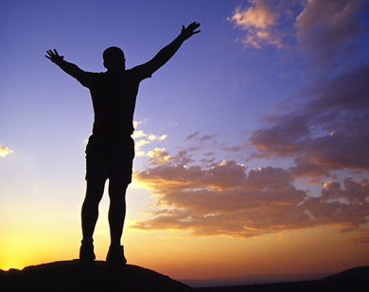
Candle 4 – Freedom
This Photo by Unknown Author is licensed under CC BY-NC

Slide 6
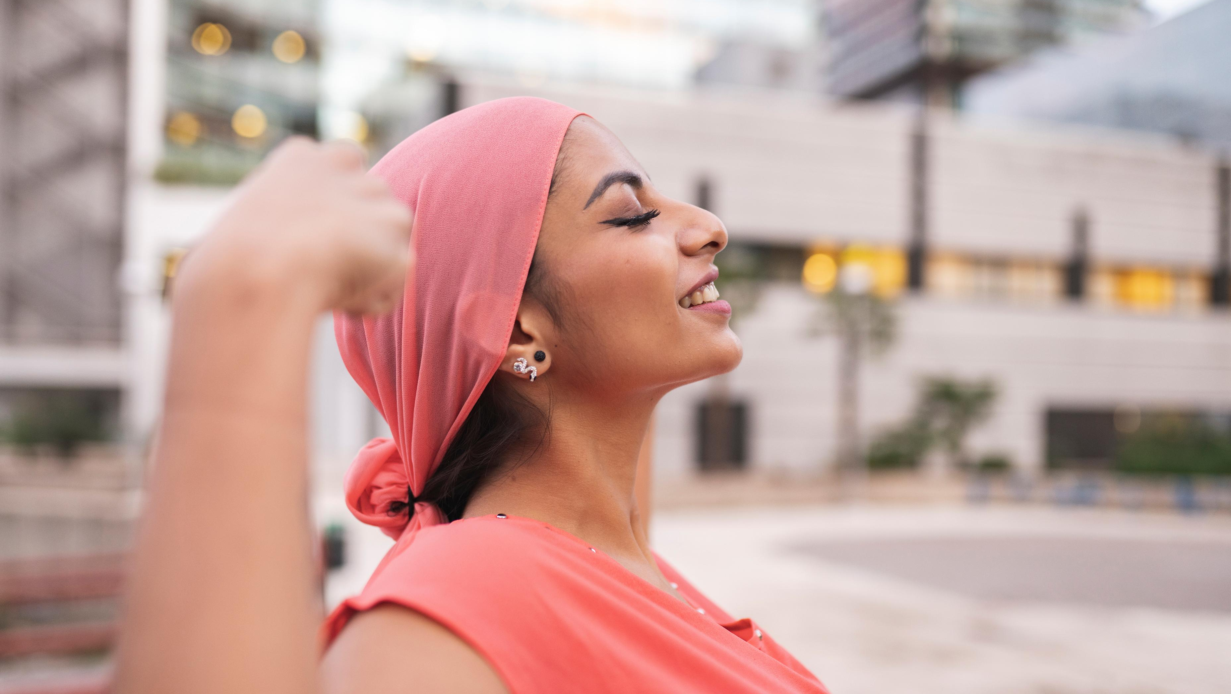
Candle 5 – Resilience

Slide 7
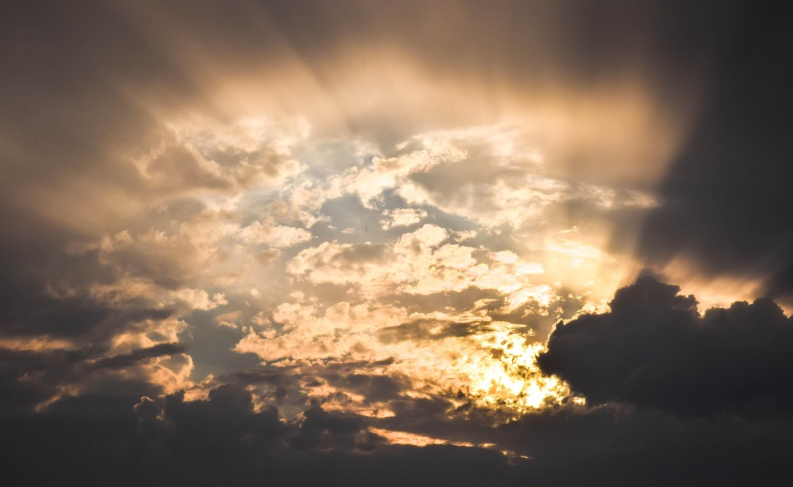
Candle 6 - Hope

Slide 8

Candle 7 – Faith

Slide 9
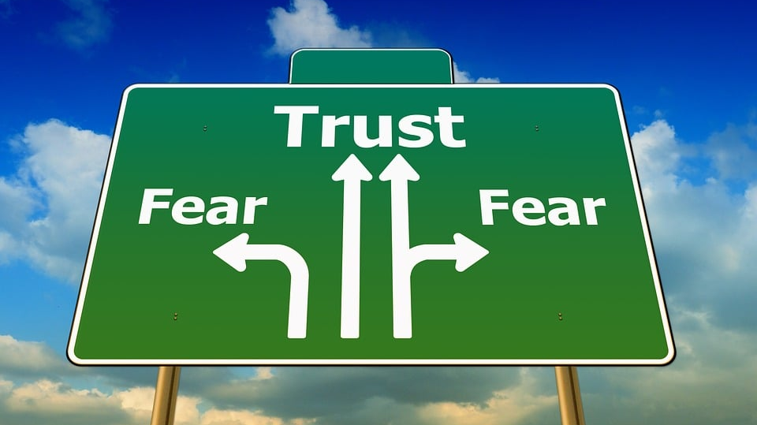
Candle 8 – Trust

